Slide 1

Equipping Elders for Effective Leadership
BOARD LEADERSHIP
Notes:
Personal Introductions
Who am I (married to Charlene…2 boys, 1 daughter-in-law)
What is my current role in the district?
Experience (lead pastor, masters degree, what was missing from my leadership?)
degree
Why are we here? – healthy boards foster healthy churches

Slide 2



THE ALLIANCE CANADA VISION
CHRIST-
CENTRED
SPIRIT-
EMPOWERED
MISSION-
FOCUSED
Notes:
Everything you do as a board is driven by Jesus and focused on Jesus
You do nothing unless empowered by the H.S.
Everything we do drives us to love our neighbours and reach people for Jesus
Great commandment
Great commission

Slide 3
Do you see yourself as a shepherd?
How does your understanding of a shepherd
and an elder intersect?

Slide 4
Equipping Elders for Effective Leadership
BOARD LEADERSHIP
Notes:
Personal Introductions
Who am I (married to Charlene…2 boys, 1 daughter-in-law)
What is my current role in the district?
Experience (lead pastor, masters degree, what was missing from my leadership?)
degree
Why are we here? – healthy boards foster healthy churches

Slide 5






/////////
ALLIANCE GOVERNANCE DISTINCTIVES
RESPONSIBILITY & ACCOUNTABILITY
SIX FOCUS AREAS
FOR BOARDS
EFFECTIVE GOVERNANCE
BY CHURCH SIZE
ROLES
ENDS OVER MEANS
/////////
TOOLS

Slide 6




BOARD RESPONSIBILITIES
The Board has a fiduciary responsibility to:
Safeguard the vision, mission, and values against unintentional drift and unauthorized shifts in purpose.
Prevent theft, waste ,or misuse of resources.
r
Ensure that resources are deployed effectively and efficiently to advance the vision.
Operate solely in the best interests
of the church.
Chait, Ryan, & Taylor
from Governance as Leadership
Notes:
- YAC – wanting to reach people in Abby vs. Yarrow

Slide 7

BOARD RESPONSIBILITIES
}
GOVERNING
&
SHEPHERDING
The Board has two primary areas of responsibility.
2
Both aspects of Board activity are spiritual in nature.

Slide 8

GOVERNING ROLE
DIRECT:
Develop ENDS – the vision, mission, values, objectives, and goals of the church
Ensure agreed upon ENDS are achieved
Regularly evaluates through the Lead Pastor whether ENDS are being achieved
////////////

Slide 9

GOVERNING ROLE
PROTECT:
Against things that would hinder achievement of the ENDS
Against endangerment of the church and its resources
////////////

Slide 10












SHEPHERDING ROLE
SERVE COMMUNION
TEACH
PROVIDE
SPIRITUAL
CARE
PRAYER MINISTRY
CONFLICT
RESOLUTION
ANOINT WITH OIL & PRAY FOR THE SICK
VISITATION
BIBLICAL
PEACEMAKING
PREACH

Slide 11

“The job of a board is to direct
and protect.”
- Jim Brown, from The Imperfect Board Member

Slide 12
The Board is Accountable to:
Jesus as Head of the Church
And he is the head of the body, the church; he is the beginning and the firstborn among the dead, so that in everything he might have supremacy.
Colossians 1:18
Church Members
District Superintendent
Governments of BC and Canada

Slide 13
The Board is Accountable to:
Jesus as Head of the Church
…at the annual meeting the members shall elect a Board from among the voting membership to be responsible for the affairs of the church between annual meetings.
Local Church Constitution, Article 7
Church Members
District Superintendent
Governments of BC and Canada

Slide 14


FORM of GOVERNANCE
REPRESENTATIVE
ELECTED
The Christian and Missionary Alliance in Canada follows a representative, or Presbyterian, form of governance.
The Board, as elected by the membership, is the highest functioning form of governance in the local church.

Slide 15
The Board is Accountable to:
Jesus as Head of the Church
The District Superintendent shall be the recognized head of the entire work of the district…
Policy on District Organization, 2.3.1
Church Members
District Superintendent
Governments of BC and Canada

Slide 16
The Board is Accountable to:
Jesus as Head of the Church
A director of a society must…
act honestly and in good faith with a view to the best interests of the society,
exercise the care, diligence and skill that a reasonably prudent individual would in comparable circumstances,
act in accordance with the Societies Act, and
act in accordance with the bylaws
Societies Act of BC, 53 (1)
Church Membership
District Superintendent
Governments of BC and Canada

Slide 17
The Board is Accountable to:
Church Members
Church Bylaws
The Christian & Missionary Alliance in Canada
Local Church Constitution,
C&MA Manual
Governments of BC and Canada
Societies Act, Income Tax Act,
PIPA, Employment Standards, etc.

Slide 18

QUESTIONS? COMMENTS?
///

Slide 19
As a Board member, in what areas of responsibility and accountability do you see the Board operating in strength?
If you could choose, what would be a focus area of accountability over the next 6 months?

Slide 20
/////////
ALLIANCE GOVERNANCE DISTINCTIVES
RESPONSIBILITY & ACCOUNTABILITY
SIX FOCUS AREAS
FOR BOARDS
EFFECTIVE GOVERNANCE
BY CHURCH SIZE
ROLES
ENDS OVER MEANS
/////////
TOOLS

Slide 21
///
EFFECTIVE GOVERNANCE
How will the Board govern
in its unique context?

Slide 22
///
EFFECTIVE GOVERNANCE
This is greatly influenced by church size.
Growing churches become increasingly complex
and require more effort to give effective oversight.

Slide 23



CHURCH SIZE INFLUENCES BOARD TYPE
POLICY
GOVERNANCE®
BOARD
600+
MANAGING
BOARD
200-600
WORKING
BOARD
<200

Slide 24
1
Responsible for overall health of the church.
WORKING
BOARD
///
2
Responsible for the core function of the church.
Assumes responsibility for preaching, teaching, and shepherding in the absence of a pastor.
3
Focus can default to operational tasks and neglect vision and long-range planning.
4

Slide 25
Works with one or more pastors or lay leaders in overseeing the church.
1
MANAGING
BOARD
///
Typical division of labour may have pastors as shepherds and the Board as managers.
2
Elders may function as the liaison between the Board and ministry leaders.
3
Effective managing boards learn to prioritize and invest time on vision, mission, and values.
4

Slide 26
POLICY
GOVERNANCE®
BOARD
///
The Board primarily focuses on the ENDS of the church and delegates the MEANS of accomplishing them to the Lead Pastor.
1
The Board gives oversight to the church through the creation and implementation of policies.
2

Slide 27



/////////
POLICY TYPES
ENDS
GOVERNANCE PROCESS
MINISTRY PROTECTION (EXECUTIVE LIMITATIONS)
BOARD – LEAD PASTOR RELATIONSHIP

Slide 28




SUGGESTIONS
FOR BOARDS
+ $195k.
RECOGNIZE YOUR CURRENT BOARD TYPE
BECOME STUDENTS
OF BOARD GOVERNANCE
IDENTIFY & ESTABLISH BEST PRACTICES
SECURE COACHING IF NEEDED

Slide 29
From your perspective, what model does your Board function with?
How effective is this model in your
church setting?

Slide 30
/////////
ALLIANCE GOVERNANCE DISTINCTIVES
RESPONSIBILITY & ACCOUNTABILITY
SIX FOCUS AREAS
FOR BOARDS
EFFECTIVE GOVERNANCE
BY CHURCH SIZE
ROLES
ENDS OVER MEANS
/////////
TOOLS

Slide 31
///
ENDS ASKS THE QUESTIONS…
What do we believe the Lord wants us to accomplish? What does he have us here to do?
THE FOCUS IS ON CHURCH:
Values
Vision
Objectives & Goals
Ministry Multiplication

Slide 32
///
MEANS ASKS THE QUESTION…
How will we get this done?
Means are the
methods & practices
used to accomplish the Ends

Slide 33
AN EXAMPLE
An Ends Statement:
Possible Means:
We collaborate with leaders and churches to make disciples who extend the message of Jesus, locally and globally.
Training Events
Church & Pastoral Visits
Leader Development Cohort

Slide 34
THE GOAL
Regardless of church size, handle every MEANS or operational item at the lowest level possible in the church’s organizational structure.
////////////

Slide 35
The Board as a whole (including the Lead Pastor) focus on ENDS.
THE FOCUS
The Lead Pastor, staff, church volunteers, and individual elders as volunteers focus on the MEANS.

Slide 36
EFFECTIVE BOARD MEETINGS
///
Always time-capped
///
Ends over Means - don’t get buried in the details
///
Come prepared
///
Don’t feel pressure to resolve everything – table items if needed
///
Always make time for shepherding

Slide 37
DECISION-MAKING FRAMEWORK
///
Role of the Chair is critical
///
Active listening
///
Set an amount of time for debate
///
Begin to sense direction
///
Come prepared to speak
///
Prayerful discernment
///
Speak to ideas not feelings
///
How decision will be made - consensus, majority, or unanimity

Slide 38
From your perspective, how is your Board doing at prioritizing Ends over Means?
How effective have your Board meetings been at advancing the vision of the church?

Slide 39
Equipping Elders for Effective Leadership
BOARD LEADERSHIP
Notes:
Personal Introductions
Who am I (married to Charlene…2 boys, 1 daughter-in-law)
What is my current role in the district?
Experience (lead pastor, masters degree, what was missing from my leadership?)
degree
Why are we here? – healthy boards foster healthy churches

Slide 40
/////////
ALLIANCE GOVERNANCE DISTINCTIVES
RESPONSIBILITY & ACCOUNTABILITY
SIX FOCUS AREAS
FOR BOARDS
EFFECTIVE GOVERNANCE
BY CHURCH SIZE
ROLES
ENDS OVER MEANS
/////////
TOOLS

Slide 41
ALLIANCE GOVERNANCE
DISTINCTIVES
///
>
ROLE OF THE LEAD PASTOR
Certain unique governance items in The Christian and Missionary Alliance require careful thought.
>
ROLE OF THE BOARD OFFICERS
>
HIRING AND ENDING EMPLOYMENT

Slide 42
ROLE OF THE
LEAD PASTOR
In The Christian and Missionary Alliance
the Lead Pastor wears several different hats...

Slide 43
ROLE OF THE LEAD PASTOR
The senior pastor of the church shall be called by the Board and appointed by the District Superintendent.
Local Church Constitution, 9.1
An employee of the Board

Slide 44
ROLE OF THE LEAD PASTOR
The senior pastor or a member of the Board appointed by the senior pastor shall be the chair. The senior pastor shall have primary responsibility for oversight of the Board and the church and shall function within the job description approved by the Board.
Local Church Constitution, 8.1
Responsible for oversight of the Board

Slide 45
ROLE OF THE LEAD PASTOR
With the exception of the senior pastor, who is a member ex-officio…
Local Church Constitution, 8.1
A member of the Board

Slide 46
ROLE OF THE LEAD PASTOR
The senior pastor or a member of the Board appointed by the senior pastor shall be the chair. The senior pastor shall have primary responsibility for oversight of the Board and the church and shall function within the job description approved by the Board.
Local Church Constitution, 8.1
Board Chair if desired

Slide 47
ROLE OF THE LEAD PASTOR
A member of the Board
Responsible for oversight of the Board
A member of the Board
Board Chair if desired
Boards (with the Lead Pastor) should discuss the different roles of the Lead Pastor.

Slide 48
QUESTIONS? COMMENTS?
///

Slide 49
ROLE OF THE CHAIR
+
Set Board meeting agendas in consultation with the Lead Pastor
+
Regularly communicate with the congregation on behalf of the Board
+
+
Ensure Board deliberation is timely, fair, orderly, thorough, and efficient
Ensure the Board meets all internal and external obligations

Slide 50
ROLE OF THE CHAIR
+
Act in conjunction with the Lead Pastor as spokesperson for Board decisions
+
Remember the Chair’s authority doesn’t include individually directing the Lead Pastor
+
+
Oversee a regularly scheduled assessment of the Board’s performance
Uphold the responsibilities of an individual elder

Slide 51
ROLE OF THE VICE-CHAIR
Assist the Chair in performance of their duties
Act as Chair in the absence of the Chair
Uphold the responsibilities of an individual elder

Slide 52
ROLE OF THE SECRETARY
Record and circulate the minutes of all Board and membership meetings
Submit Board minutes to the next scheduled Board meeting after the minutes were taken
Maintain master copies of church policies, bylaws, and property and legal records

Slide 53
ROLE OF THE SECRETARY
Issue and maintain the official correspondence for the Board
Maintain a file of all Board documents and membership meeting minutes of the church that constitute the official, permanent record
Uphold the responsibilities of an individual elder

Slide 54

ROLE OF THE
TREASURER

Slide 55
ROLE OF THE TREASURER
The Treasurer shall ensure that all funds of the church are received and disbursed as directed by the Board, shall ensure that proper records are maintained, and shall report as required.
Local Church Constitution, 8.3.4

Slide 56
ROLE OF THE TREASURER
Provide oversight to financial affairs of the church
Ensure church funds are received and disbursed as directed by the Board
Provide leadership, expertise, and advice to the Board on financial matters
Ensure proper financial records are maintained

Slide 57
ROLE OF THE TREASURER
Act as a signing officer for the church
Regularly review financial reporting, internal control, and financial management practices and make recommendations to the Board
Chair the church’s Finance Committee (if applicable)
Uphold the responsibilities of an individual elder

Slide 58
REMINDERS FOR TREASURERS
Individual Board members, including Treasurers, do not have oversight of staff activity
The Lead Pastor is responsible for administration of the budget

Slide 59
REMINDERS FOR TREASURERS
Cash flow may influence the timing of budgeted expenditures; however, the Treasurer does not have authority over any church staff
The Board may write policy to insulate against any friction in this area

Slide 60
REMINDERS FOR TREASURERS
Be aware of annual financial obligations including preparation of financial statements, T3010 filing, and budget preparation
The Church Treasurer Manual is available on myCPD

Slide 61
QUESTIONS? COMMENTS?
///

Slide 62
HIRING STAFF
+
Lead Pastor candidates are called by the Board and appointed by the District Superintendent (Local Church Constitution, 9.2)
+
Candidates for pastoral/ministry roles must be licensed prior to being hired or the employment offer must be subject to successful licensing
+
All other pastoral/ministry candidates and non-ministry roles are hired at the discretion and approval of the Lead Pastor and Board
+
Imperative for every hire, regardless of role, to have a proper offer of employment, employment contract, and job description
Notes:
Understand the risk of not being licensed prior to passing licensing…important how to communicate this to your congregation.

Slide 63
ENDING EMPLOYMENT
+
Lead Pastors resign from the church by giving notice to the
District Superintendent and the Board
+
The Lead Pastor, with Board approval and after consultation with the
District Superintendent, may terminate the employment of staff
+
If termination of employment of any ministry staff is being considered, consult the District Office first!

Slide 64
QUESTIONS? COMMENTS?
///

Slide 65
Equipping Elders for Effective Leadership
BOARD LEADERSHIP
Notes:
Personal Introductions
Who am I (married to Charlene…2 boys, 1 daughter-in-law)
What is my current role in the district?
Experience (lead pastor, masters degree, what was missing from my leadership?)
degree
Why are we here? – healthy boards foster healthy churches

Slide 66
/////////
ALLIANCE GOVERNANCE DISTINCTIVES
RESPONSIBILITY & ACCOUNTABILITY
SIX FOCUS AREAS
FOR BOARDS
EFFECTIVE GOVERNANCE
BY CHURCH SIZE
ROLES
ENDS OVER MEANS
/////////
TOOLS

Slide 67
A CLEAR UNDERSTANDING
OF THE ROLES OF:
Board
Lead Pastor as employee
Individual elders
Church staff – pastoral and support
////////////

Slide 68
When the Board is in formal meetings
When the Board is NOT in formal meetings
LEAD
PASTOR
BOARD
ROLES
&
AUTHORITY
DELEGATION
STAFF, VOLUNTEERS, REST OF CHURCH
Including individual elders
LEAD
PASTOR

Slide 69
ROLE OF THE BOARD
Only has authority as a Board, expressed through motions and policies
Report regularly to church membership, including the AGM
Speak with one voice as a Board through the motions passed
Establish policies and refine them as necessary
Ensure individual elders do not speak or act on behalf of the Board without permission
////////////

Slide 70
ROLE OF THE BOARD
Uphold the vision, mission, values, objectives, and goals of the church
Ensure the Lead Pastor fulfills their job description and annually or biennially conduct a review
Maintain confidentiality for information and discussions brought to Board meetings
Work in consultation with the District Office to hire or terminate employment of the Lead Pastor
Develop clear expectations for all reports to the Board
////////////

Slide 71
ROLE OF THE BOARD
Ensure effective flow of information between the
Board, Lead Pastor, and staff
Uphold the policies and operational processes of the church
Lead staff through the Lead Pastor
Monitor the Board’s effectiveness in following its policies
////////////

Slide 72
ROLE OF THE BOARD
Ensure the officers of the Board are fulfilling their roles and mandates
Orient new Board and church members to the governance structure
Establish committees to assist the Board as needed
Establish processes that effectively navigate conflict
////////////

Slide 73

LEVELS OF INTERVENTION
INFORMAL
DISCUSSION
INFORMAL
MEDIATION
FACILITATED
GROUP
DIALOGUE
NEGOTIATION
COACHING
MEDIATION
ARBITRATION
LITIGATION
Notes:
Examples:
Informal discussion – staff member points out to LP there is a better way to move forward in a situation…something is bubbling up but not in a conflict
Negotiation – difference in opinion between staff & LP or LP & Board and are trying to work it out together
Coach - difference in opinion between staff & LP or LP & Board and are trying to work it out together but need to bring a 3rd party in to help who is coaching sides individually
Informal Mediation – a 3rd party is sitting down with two parties together to facilitate a resolution…could be internal person or in sphere of influence but they may not be a professional
Facilitated Group Dialogue – more structured dialogue led by a Board or outside entity…district starts to become involved
Mediation – beyond internal skillsets to resolve the issue/situation and professionals are involved
Arbitration – the issue/situation is not resolvable, and a 3rd party determines the solution or resolution
Litigation – disagreement with the arbitration decision and law courts are involved to determine resolution
Levels 1-4 there can be win-wins, Level 5 and higher there will be wins and losses or multiple losses

Slide 74
ROLE OF AN ELDER
Avoid any conduct, speech, activity, or conflict that would hinder the work or integrity of the Board, according to biblical eldership
Is prudent and uses godly wisdom and common sense in decision making and conduct
Act in good faith with honesty and integrity, keeping the church’s best interests in mind
////////////

Slide 75
ROLE OF AN ELDER
Attend Board meetings consistently, fully engage in meetings, and is well prepared
Honour confidentiality
Bring expertise, experience, insight, giftedness, and energy when serving on the Board
////////////

Slide 76
ROLE OF THE LEAD PASTOR
Primary oversight of the health and vitality of the church
Organize and leads other staff
Work collaboratively with Board Chair to ensure effective Board function
Ensure appropriate personnel are in place to achieve the Ends

Slide 77
ROLE OF THE LEAD PASTOR
Initiate staff hiring process according to guidelines established by the Board and District
Ensure each staff member has a written job description in place
Ensure staff compliance to any protective policies adopted by the Board
Ensure staff reviews take place

Slide 78
ROLE OF CHURCH STAFF
Are not members of the Board & may not vote
Take direction from the Board only through the Lead Pastor or designate, & are not directed by an individual elder
May attend Board meetings at the discretion of the Board (in consultation with the Lead Pastor)
Communicate with Board through the Lead Pastor unless another reporting mechanism is approved
Accountable to the Lead Pastor or their designate

Slide 79
QUESTIONS? COMMENTS?
///

Slide 80
/////////
ALLIANCE GOVERNANCE DISTINCTIVES
RESPONSIBILITY & ACCOUNTABILITY
SIX FOCUS AREAS
FOR BOARDS
EFFECTIVE GOVERNANCE
BY CHURCH SIZE
ROLES
ENDS OVER MEANS
/////////
TOOLS

Slide 81







SEVEN
POWERFUL TOOLS
MEETING
AGENDA
BOARD SELF-ASSESSMENT
CONSENT
AGENDA
CHURCH DASHBOARD
DECISION
PROFILE
DISCUSSION PROFILE
MEETING MINUTES

Slide 82
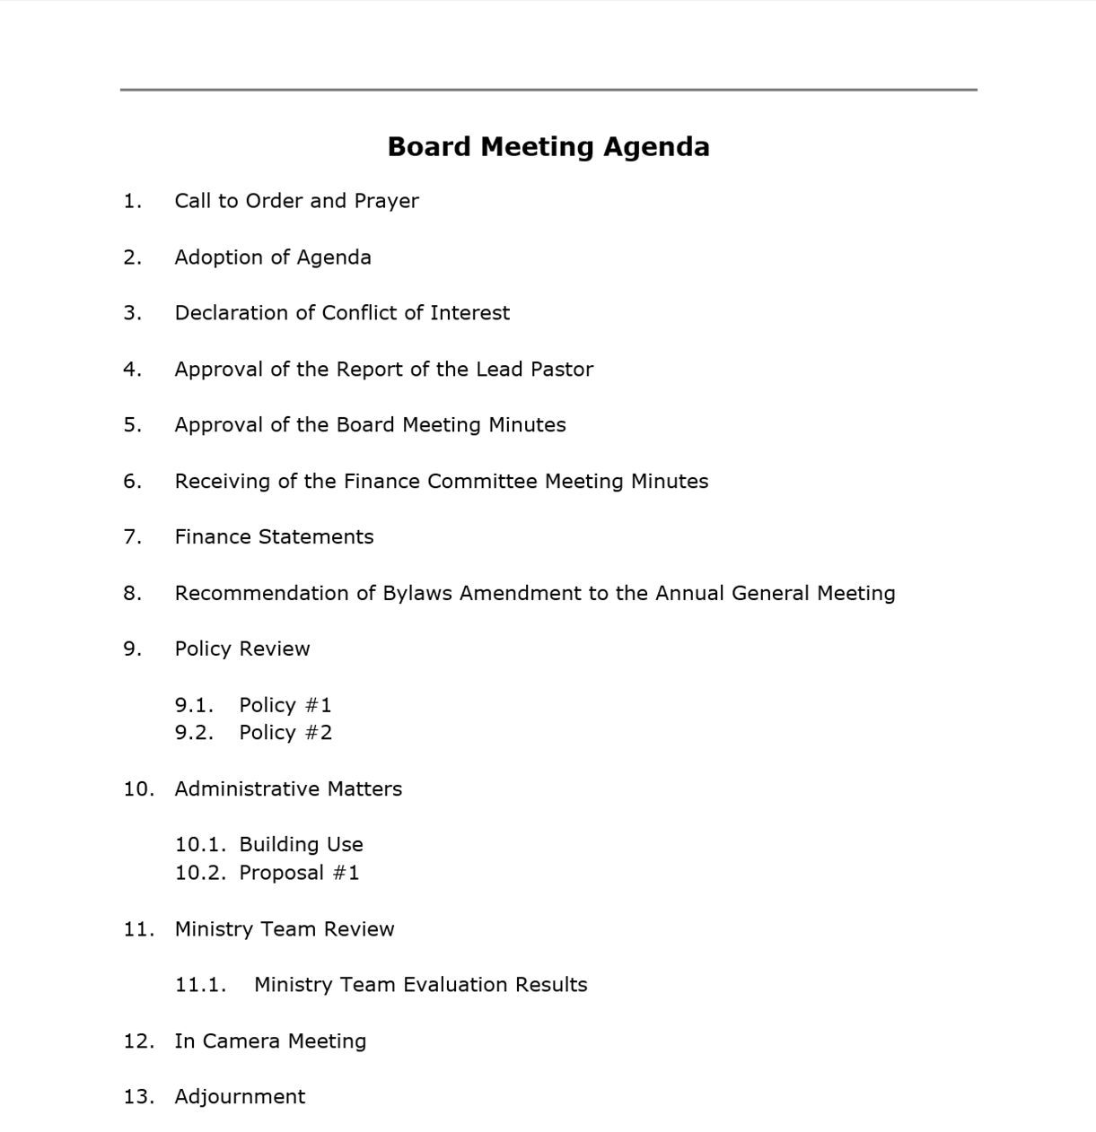
Meeting Agenda
Preparation & Flow
Use a meeting agenda help participants prepare and to direct the conversations
2 weeks prior to meeting
1 week prior to meeting
Agenda prepared
Agenda Distributed
Board Meeting

Slide 83
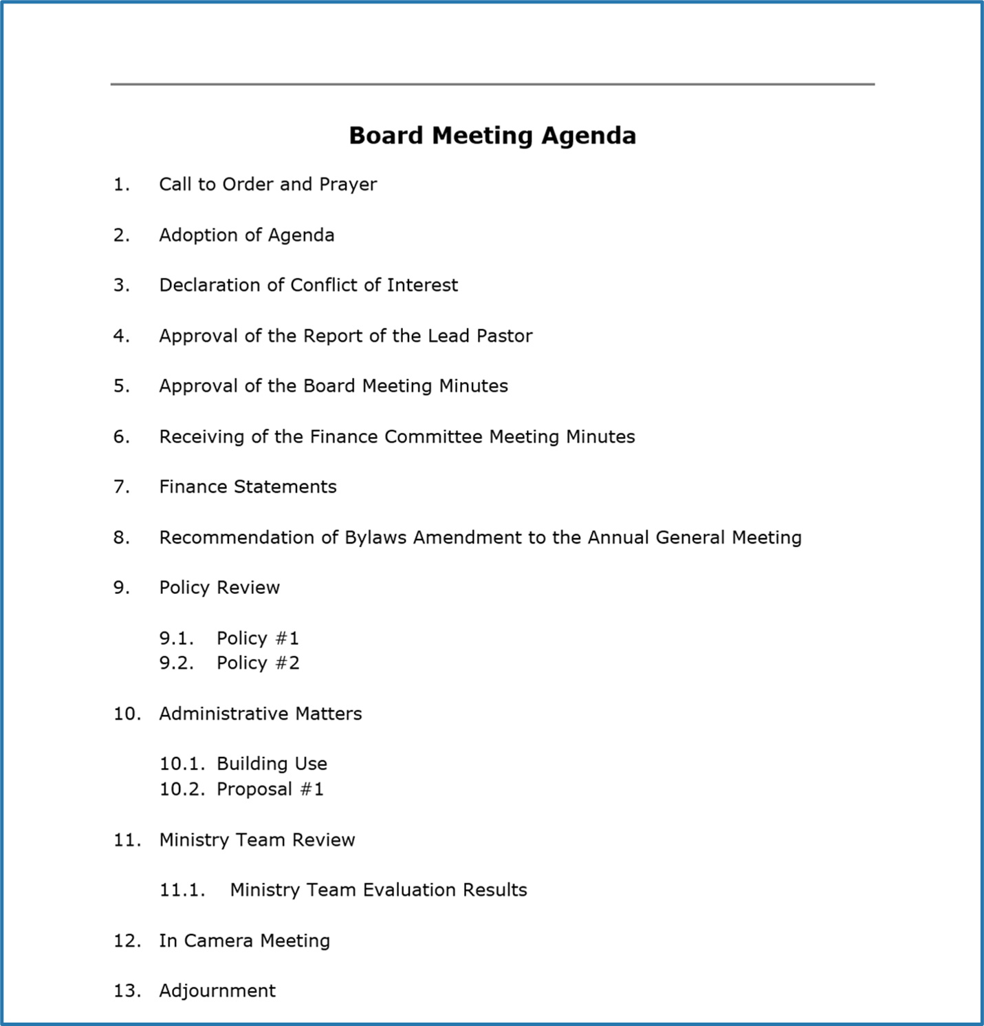
Consent Agenda
WHAT IS IT?
Items to group
Way to quickly adopt a group of routine items that all require a formal motion of adoption but don’t require separate motions

Slide 84
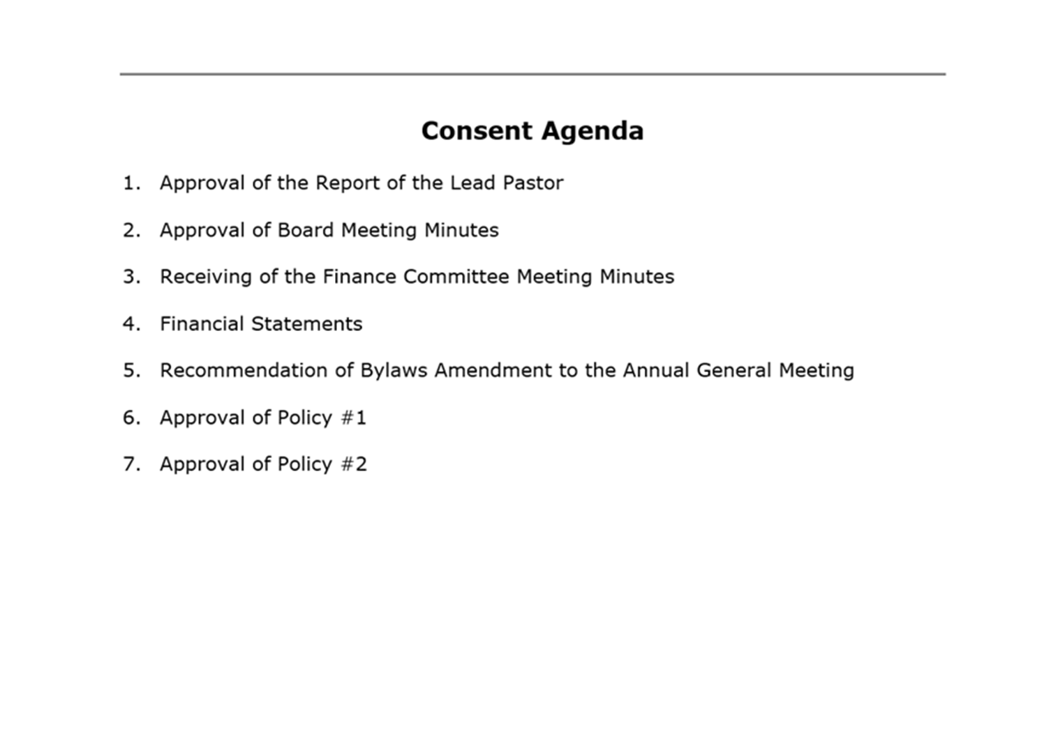
Consent Agenda
WHY USE IT?
To save time normally spent on routine items
To group items together and treat them as one agenda item

Slide 85
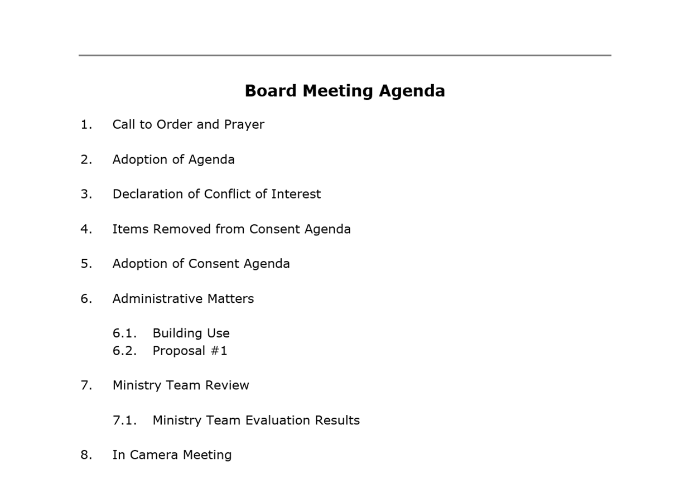
Consent Agenda
HOW DO YOU USE IT?
List routine items together and by consent, adopt simultaneously
A place on the regular agenda is provided for items removed from the Consent Agenda due to questions or comments

Slide 86
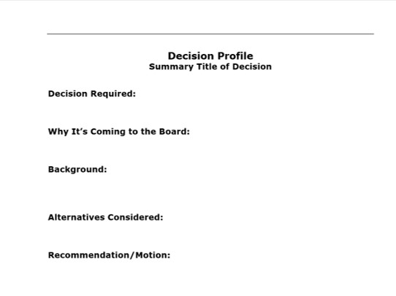
Decision Profile
Provides information to reflect on a decision prior to the meeting
Gives time to process important decisions
Prepare to make an informed decision at the Board meeting
Notes:
People process information in different ways & at different speeds
Gives those who prefer to develop their perspectives & opinions over several days the time to do so

Slide 87
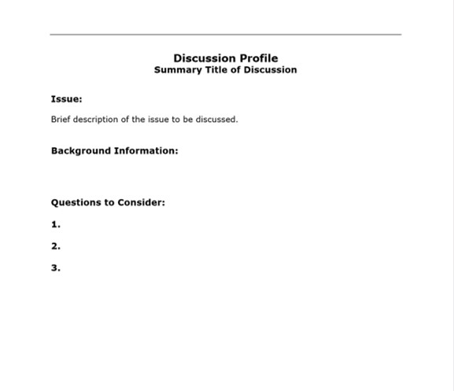
Discussion Profile
Raises discussion on an important issue before moving it to a decision
Uses a spiritual discernment process to listen to Jesus
Discuss the issue over at least 2 meetings before moving to a decision
Notes:
List options available to deal with the issue
Give any additional information required to move forward to a decision
When there is uncertainty about the mind of the Lord and there is a lot at stake
Make room for the Holy Spirit to speak

Slide 88
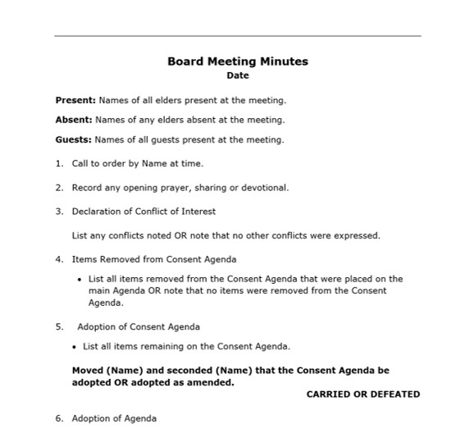
Meeting Minutes
Provides a clear and concise record of each Board meeting
Each decision and succinct relevant conversation is recorded
In Camera discussions are not recorded

Slide 89
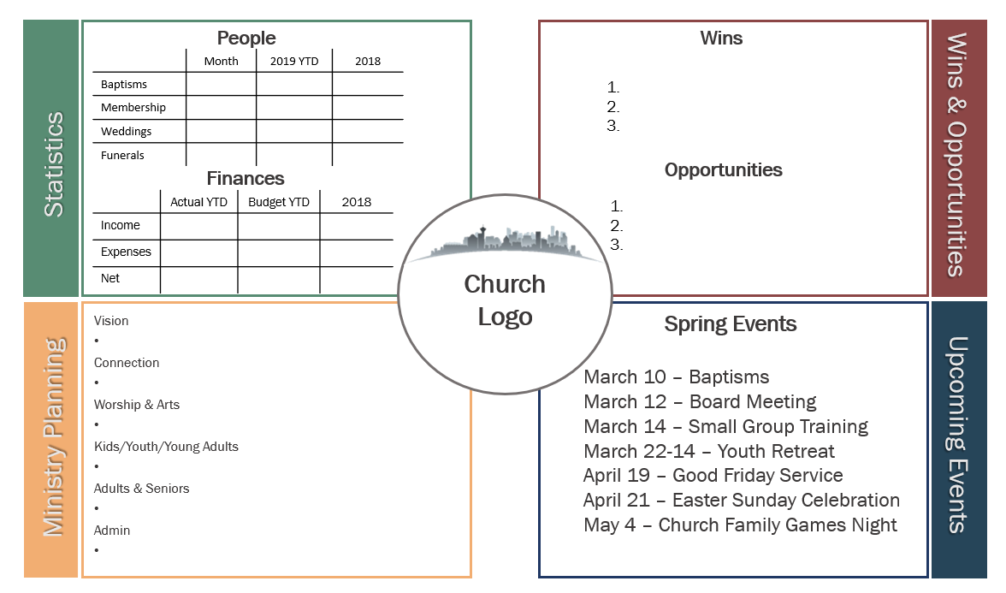
Church Dashboard
Provides a snapshot of church information at each Board meeting
Each area is updated with information to give a clear picture of the current status
Notes:
People process information in different ways & at different speeds
Gives those who prefer to develop their perspectives & opinions over several days the time to do so

Slide 90
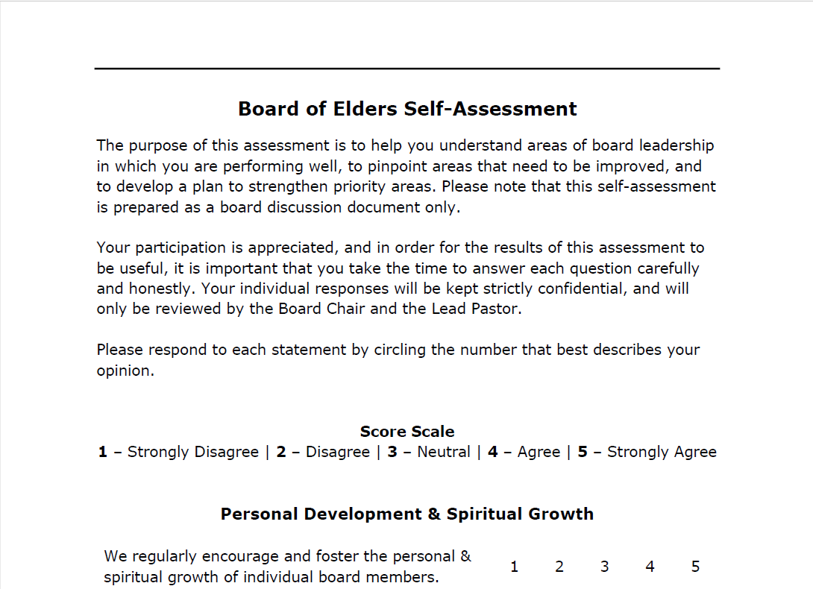
Board Self-Assessment
Helps you understand strengths and pinpoints areas to improve in
Each Board member completes the self-assessment and the Board as a whole discusses the results

Slide 91
QUESTIONS? COMMENTS?
///

Slide 92
Equipping Elders for Effective Leadership
BOARD LEADERSHIP
Notes:
Personal Introductions
Who am I (married to Charlene…2 boys, 1 daughter-in-law)
What is my current role in the district?
Experience (lead pastor, masters degree, what was missing from my leadership?)
degree
Why are we here? – healthy boards foster healthy churches

Slide 93

This manual is a partnership project between the Canadian Pacific District (CPD) of the Christian and Missionary Alliance in Canada, Steve Schneider, and Gerry Teichrob.
pacificdistrict.ca
Except where otherwise noted, Scripture quotations are taken from the New International Version© 2011 by Biblica.

